Slide 1
Regression and Logistic Regression
南晓斐

Slide 2
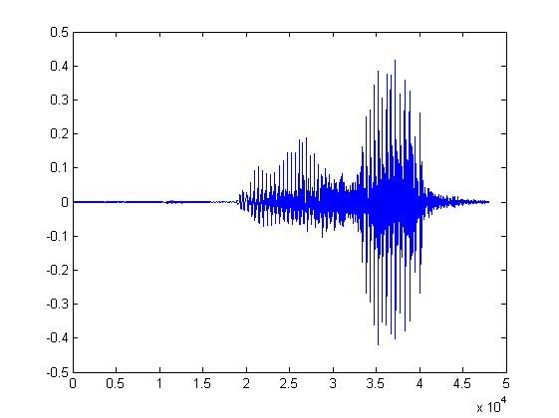

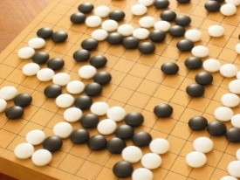
Machine Learning ≈ Looking for Function
Speech Recognition
Image Recognition
Playing Go
“How are you”
“Cat”
“5-5”
(next move)
Notes:
From Data

Slide 3

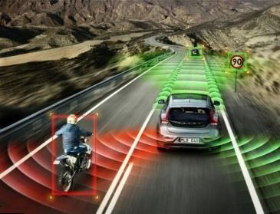
Stock Market Forcast
Self-Driving car
Recommendation
Dow Jones Industrial Average at tomorrow
方向盘角度
使用者A 商品B
购买的可能性

Slide 4

Different types of Functions
Regression: The function outputs a scalar.
Predict PM2.5
PM2.5 today
f
temperature
PM2.5 of tomorrow
Concentration
of O₃
Classification: Given options (classes), the function outputs the correct one.
Spam
filtering
f
Yes/No

Slide 5

The function we want to find …
$$y=f\left( \right)$$
y :# of likes. regression
y :popular or not. classification

Slide 6
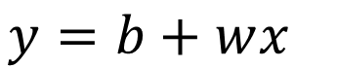
1. Function with Unknown Parameters
$$y=f\left( \right)$$
Model
$$y=b+wx_{}$$
based on domain knowledge
feature
$y:$ likes , $x_{}:$ view counts
$w$ and $b$ are unknown parameters (learned from data)
weight
bias

Slide 7
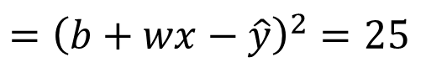
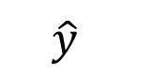
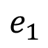
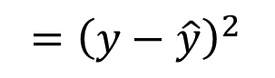
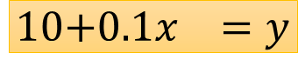
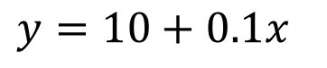
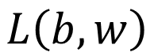
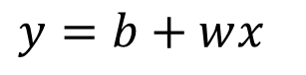
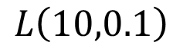
2. Define Loss from Training Data
Loss is a function of parameters
$$L\left(b,w\right)$$
Loss: how good a set of values is.
$$L\left(10,0.1\right)$$
$$y=b+wx_{}$$
$$y=10+0.1x_{}$$
How good it is?
Lots of training examples
……
x¹
x²
x³
x^{n-1}
x^{n}
30
36
66
708
922
$$\text{1}\text{0}\text{+}0.1x_{}=y$$
$$e_{1}$$
$$={\left(y−\hat{y}\right)}^{2}$$
$$={\left(b+wx−\hat{y}\right)}^{2}=25$$
label
$$\hat{y}$$
8
Notes:
Mean Square Error (MSE)

Slide 8
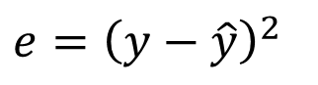
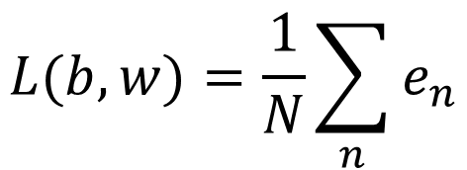
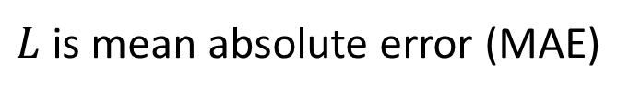
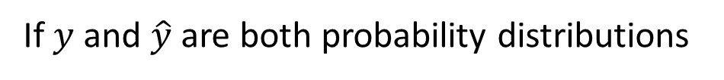
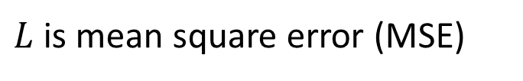
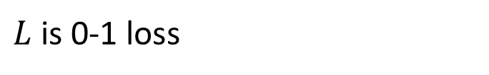
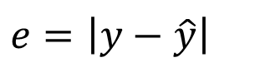
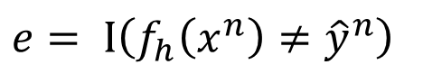
2. Define Loss from Training Data
Loss is a function of parameters
$$L\left(b,w\right)$$
Given a data set
$$𝒟=\left\{\left(x^{1},{\hat{y}}^{1}\right),\left(x^{2},{\hat{y}}^{2}\right),⋯,\left(x^{N},{\hat{y}}^{N}\right)\right\}$$
Loss:
$$L(b,w)=\frac{1}{N}\sum_{n}{e_{n}}$$
$$e=\left|y−\hat{y}\right|$$
$L$ is mean absolute error (MAE)
$$e={\left(y−\hat{y}\right)}^{2}$$
$L$ is mean square error (MSE)
$$e= I\left(f_{h}\left(x^{n}\right)≠{\hat{y}}^{n}\right)$$
$L$ is 0-1 loss
If $y$ and $\hat{y}$ are both probability distributions
Cross-entropy

Slide 9
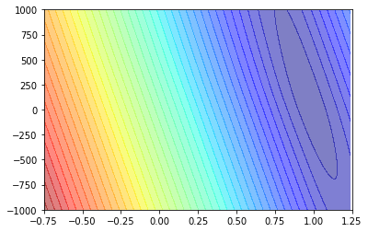
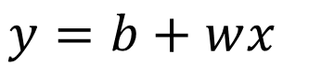


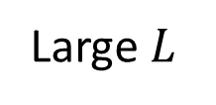
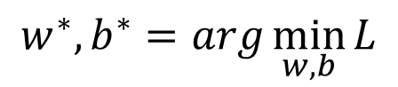

2. Define Loss from Training Data
Model
$$y=b+wx_{}$$
$$w^{∗},b^{∗}=arg\min_{w,b}{L}$$
Small $L$
$$b$$
Error Surface
Large $L$
$$w$$
Notes:
MAE

Slide 10

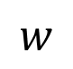
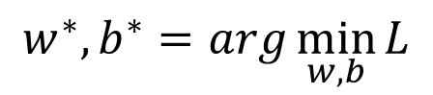
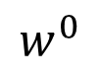
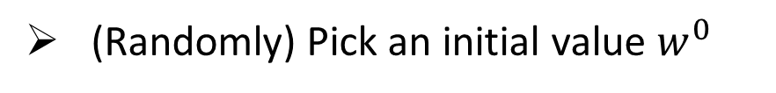
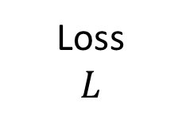
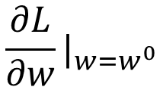
3. Optimization
$$w^{∗},b^{∗}=arg\min_{w,b}{L}$$
Gradient Descent
(Randomly) Pick an initial value $w^{0}$
$$\frac{∂L}{∂w}|_{w=w^{0}}$$
Compute
Loss
$$L$$
Negative
Increase w
Positive
Decrease w
$$w^{0}$$
$$w$$
Notes:
In this case, this optimization problem can be solved directly.

Slide 11
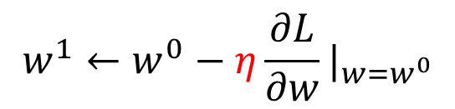
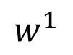
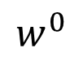
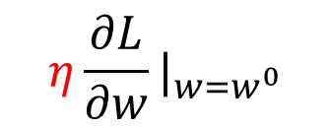
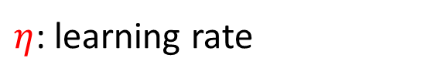
3. Optimization
Source of image: http://chico386.pixnet.net/album/photo/171572850
$$w^{∗},b^{∗}=arg\min_{w,b}{L}$$
Gradient Descent
(Randomly) Pick an initial value $w^{0}$
$$\frac{∂L}{∂w}|_{w=w^{0}}$$
Compute
Loss
$$L$$
$$w^{1}←w^{0}−η\frac{∂L}{∂w}|_{w=w^{0}}$$
$$η\frac{∂L}{∂w}|_{w=w^{0}}$$
$η$: learning rate
hyperparameters
$$w^{0}$$
$$w^{1}$$
$$w$$
Notes:
Eta
In this case, this optimization problem can be solved directly.

Slide 12
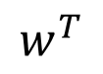

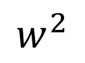
3. Optimization
Source of image: http://chico386.pixnet.net/album/photo/171572850
$$w^{∗},b^{∗}=arg\min_{w,b}{L}$$
Gradient Descent
(Randomly) Pick an initial value $w^{0}$
$$\frac{∂L}{∂w}|_{w=w^{0}}$$
Compute
Loss
$$L$$
$$w^{1}←w^{0}−η\frac{∂L}{∂w}|_{w=w^{0}}$$
Update $w$ iteratively
Local minima
global minima
$$w^{0}$$
$$w^{1}$$
$$w^{2}$$
$$w^{T}$$
$$w$$
Notes:
In this case, this optimization problem can be solved directly.

Slide 13
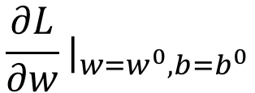
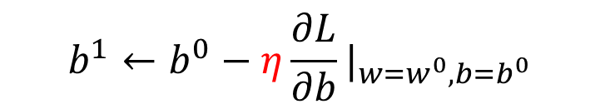
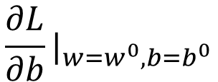

3. Optimization
$$w^{∗},b^{∗}=arg\min_{w,b}{L}$$
(Randomly) Pick initial values $w^{0}$, $b^{0}$
Compute
$$\frac{∂L}{∂w}|_{w=w^{0},b=b^{0}}$$
$$w^{1}←w^{0}−η\frac{∂L}{∂w}|_{w=w^{0},b=b^{0}}$$
$$\frac{∂L}{∂b}|_{w=w^{0},b=b^{0}}$$
$$b^{1}←b^{0}−η\frac{∂L}{∂b}|_{w=w^{0},b=b^{0}}$$
Can be done in one line in most deep learning frameworks
Update $w$ and $b$ interatively

Slide 14
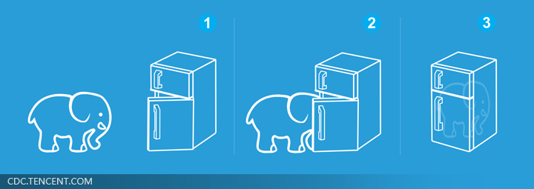
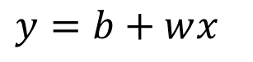
Machine Learning is so simple ……
Step 1: function with unknown
Step 2: define loss from training data
Step 3: optimization
$$y=b+wx_{}$$

Slide 15
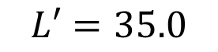
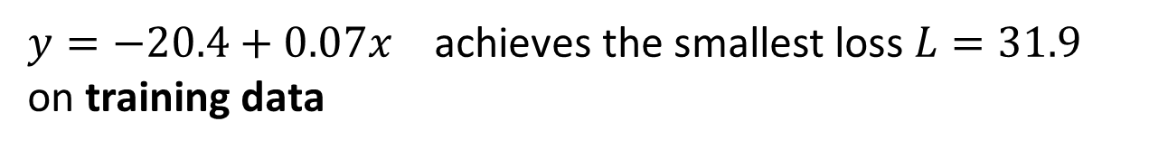
Machine Learning is so simple ……
Step 1: function with unknown
Step 2: define loss from training data
Step 3: optimization
$$y=b+wx_{}$$
Training
$y=−20.4+0.07x_{}$ achieves the smallest loss $L=31.9$
on training data
How about data of unseen data/ future data?
There is a test set about the generalization
$L′=35.0$

Slide 16
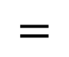
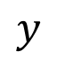
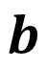
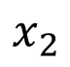
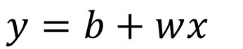










$$y=b+wx_{}$$
$$x_{1}$$ | views | 1100
$$x_{2}$$ | type | living
$$x_{3}$$ | dates | 52
$$x_{4}$$ | bullet screen | 240
$$y=b+\sum_{j=1}^{d}{w_{j}}x_{j}$$
Linear models
$$x$$
$$W$$
$$x_{1}$$
$$y$$
$$=$$
$$b$$
+
$$W$$
$$x$$
$$y$$
$$x_{2}$$
+
…
$$b$$
1
$$x_{d}$$

Slide 17









$$y=\sum_{j=0}^{d}{w_{j}}x_{j}$$
Linear models
$$x$$
$$y$$
$$=$$
$$W$$
$$x$$
$$W$$
$$x_{0}$$
$$b$$
$$x_{1}$$
$$y$$
$$x_{2}$$
+
…
$$x_{d}$$

Slide 18

Non-Linear models
$$y=b+\sum_{j=1}^{d}{w_{j}}x_{j}+\sum_{i,j=1}^{d}{w_{i,j}}{xix}_{j}$$
$y=b+\sum_{j=1}^{d}{w_{j}}x_{j}+\sum_{i,j=1}^{d}{w_{ij}}{xix}_{j}$+$\sum_{i,j,k=1}^{d}{w_{ijk}}{xix}_{j}x_{k}$

Slide 19




Machine learning workflow
Step 1: function with unknown parameters
Step 2: define loss from training data
Step 3: optimization
Training /protocol of learning algorithms

Slide 21

Training/Validation/Testing
Training: Given a model set, train a model using training data.
Validation: select the best model among several trained models using validation set
Testing: to see the performance of the model on test set.
$$h_{i}^{∗}=arg\min_{h}{L\left(h, D_{train}\right), h∈H_{i}}$$
$$h^{∗}=arg\min_{h}{L\left(h, D_{val}\right), h∈\{h_{1}^{∗},h_{2}^{∗},h_{3}^{∗},…\}}$$

Slide 22
Logistic Regression

Slide 23
Example: Bilibili video popularity prediction
$$y=f\left( \right)$$
y :# of likes. regression
y :popular or not. Classification
binary classification:
(
1
)
ideal f (x) = sign P(+1
|x) − ∈{+1，-1}
2

Slide 24
Example: Bilibili video popularity prediction
$$y=f\left( \right)$$
y :# of likes. regression
y :popular or not. Classification
y : probability of being popular logistic regression
‘soft’ binary classification:
f (x) = P(+1|x) ∈ [0, 1]

Slide 25
Soft Binary Classification
target function f (x) = P(+1|x) ∈ [0, 1]
ideal (noiseless) data actual (noisy) data
= P(+1|x¹)
= P(+1|x²)
.
= P(+1|x^{N} ) x^{N}, y^{N}
= ◦ ∼ P(y|x¹)
= × ∼ P(y|x²)
= × ∼ P(y|x^{N} )
1
1
x¹, y¹
x², y²
x , y = 0.9
x , y = 0.2
2
2
..
.
.
.
N
N
x , y = 0.6
same data as hard binary classification, different target function

Slide 26
Soft Binary Classification
target function f (x) = P(+1|x) ∈ [0, 1]
ideal (noiseless) data actual (noisy) data
= P(+1|x¹)
= P(+1|x²)
.
= P(+1|x^{N} ) x^{N}, y^{N}
= +1 ∼ P(+1|x¹)
= 0 ∼ P(+1|x²)
= 0 ∼ P(+1|x^{N} )
1
1
x¹, y¹
x², y²
x , y = 0.9
x , y = 0.2
2
2
..
.
.
.
N
N
x , y = 0.6
same data as hard binary classification, different target function

Slide 27




Logistic Hypothesis
$$x_{1}$$ | views | 1100
$$x_{2}$$ | type | living
$$x_{3}$$ | dates | 52
$$x_{4}$$ | bullet screen | 240
For x = ( x₁, x₂, · · · , x_{d} ) ‘features of video’, calculate a weighted ‘popular score’:
z= $\sum_{i=1}^{d}{w_{i}x_{i}+b}$
convert the score to estimated probability by sigmoid function $δ$(z)
logistic hypothesis: h(x) = $δ$($\sum_{i=1}^{d}{w_{i}x_{i}+d)}$

Slide 28





Sigmoid Function
$δ$(−∞) = 0;
$δ$(0) = ¹ ;
$δ$(∞) = 1
2
_{e}z
1
$δ$(z) =
=
1 + e^{z} 1 + e^{−z}
—smooth, monotonic, sigmoid function of z
logistic regression: use
1
h(x) =
1 + exp(−$\sum_{i=1}^{d}{w_{i}x_{i}+d}$ )
to approximate target function f (x) = P(+1|x)

Slide 29

Machine Learning is so simple ……
Step 1: function with unknown
Step 2: define loss from training data
Step 3: optimization
$$y=δ\text{(}\sum_{i=1}^{d}{w_{i}x_{i}+b}\text{)}$$

Slide 30






Step 1: Function Set
$$x$$
Linear Model
$$y=σ(\sum_{j=1}^{d}{w_{j}}x_{j}+b)$$
$$σ\left(z\right)=\frac{1}{1+e^{z}}$$
$$W$$
$$x_{1}$$
$$y$$
$$x_{2}$$
+
…
$$b$$
1
$$x_{d}$$
+
$$W$$
$$x$$
$$σ\left( \right)$$
$$y$$
$$=$$
$$b$$

Slide 31


Slide 32


Slide 33


Slide 34


Slide 35


Slide 36


Slide 37


Slide 38


Slide 39


Slide 40


Slide 41


Slide 42


Slide 43


Slide 44


Slide 45


Slide 46


Slide 47


Slide 48
Theory of Model Complexity

Slide 49




Training Examples
If we can collect all videos in bilibili $𝒟_{all}$, we can find the best model $h^{all}$, ($linear model h:y$= wx +b)
We only collect some examples $𝒟_{train}$ from $𝒟_{all}$
$$h^{all}=arg\min_{h}{L\left(h,𝒟_{all}\right)}$$
$$𝒟_{train}=\left\{\left(x^{1},{\hat{y}}^{1}\right),\left(x^{2},{\hat{y}}^{2}\right),⋯,\left(x^{N},{\hat{y}}^{N}\right)\right\}$$
$$\left(x^{n},{\hat{y}}^{n}\right)\sim 𝒟_{all}$$
independently and identically distributed (i.i.d.)
$$h^{train}=arg\min_{h}{L\left(h,𝒟_{train}\right)}$$

Slide 50



Training Examples
If we can collect all videos in bilibili $𝒟_{all}$, we can find the best model $h^{all}$
We only collect some examples $𝒟_{train}$ from $𝒟_{all}$
$$h^{all}=arg\min_{h}{L\left(h,𝒟_{all}\right)}$$
理想
$$h^{train}=arg\min_{h}{L\left(h,𝒟_{train}\right)}$$
现实
We hope $L\left(h^{train},𝒟_{all}\right)$ and $L\left(h^{all},𝒟_{all}\right)$ are close.
现实
理想

Slide 51




What do we want?
$$L\left(h^{train},𝒟_{all}\right)−L\left(h^{all},𝒟_{all}\right)≤δ$$
We want
What kind of $𝒟_{train}$ fulfill it?
$∀h∈ℋ,|L\left(h,𝒟_{train}\right)−L\left(h,𝒟_{all}\right)|≤δ$/2
$𝒟_{train}$ is a good proxy of $𝒟_{all}$ for evaluating loss $L$ given any $w$.
Notes:
Can we always get good performance on $L\left(w^{∗},𝒟_{train}\right)$ ?

Slide 52




What do we want?
$$L\left(h^{train},𝒟_{all}\right)−L\left(h^{all},𝒟_{all}\right)≤δ$$
We want
What kind of $𝒟_{train}$ fulfill it?
$∀h∈ℋ,|L\left(h,𝒟_{train}\right)−L\left(h,𝒟_{all}\right)|≤δ$/2
$$L\left(h^{train},𝒟_{all}\right)≤L\left(h^{train},𝒟_{train}\right)+δ\text{/}\text{2}$$
$$≤L\left(h^{all},𝒟_{train}\right)+δ\text{/}\text{2}$$
$$h^{train}=arg\min_{h}{L\left(h,𝒟_{train}\right)}$$
$$≤L\left(h^{all},𝒟_{all}\right)+δ\text{/}\text{2}+δ\text{/}\text{2}$$
$$=L\left(h^{all},𝒟_{all}\right)+δ$$
Notes:
Can we always get good performance on $L\left(h^{∗},𝒟_{train}\right)$ ?

Slide 53


What do we want?
$$L\left(h^{train},𝒟_{all}\right)−L\left(h^{all},𝒟_{all}\right)≤δ$$
We want
What kind of $𝒟_{train}$ fulfill it?
$∀h∈ℋ,|L\left(h,𝒟_{train}\right)−L\left(h,𝒟_{all}\right)|≤δ$/2
We want to sample good $𝒟_{train}$
$$ε=δ\text{/2}$$
$$∀h∈ℋ,|L\left(h,𝒟_{train}\right)−L\left(h,𝒟_{all}\right)|≤ε$$
What is the probability of sampling bad $𝒟_{train}$?
Notes:
Can we always get good performance on $L\left(h^{∗},𝒟_{train}\right)$ ?

Slide 54



Probability of Failure
good $𝒟_{train}$
bad $𝒟_{train}$
If a $𝒟_{train}$ is bad,
at least one $h$ makes $|L\left(h,𝒟_{train}\right)−L\left(h,𝒟_{all}\right)|>ε$
Each point is a training set.
Notes:
Can we always get good performance on $L\left(h^{∗},𝒟_{train}\right)$ ?

Slide 55

Probability of Failure
Each point is a training set.
$$P\left(𝒟_{train} is bad\right)$$
Notes:
Can we always get good performance on $L\left(h^{∗},𝒟_{train}\right)$ ?

Slide 56






Probability of Failure
Each point is a training set.
If a $𝒟_{train}$ is bad,
at least one $h$ makes $|L\left(h,𝒟_{train}\right)−L\left(h,𝒟_{all}\right)|>ε$
$$P\left(𝒟_{train} is bad due to h_{1}\right)$$
$$P\left(𝒟_{train} is bad due to h_{2}\right)$$
$$h_{2}$$
$$h_{1}$$
$$h_{3}$$
Notes:
Can we always get good performance on $L\left(h^{∗},𝒟_{train}\right)$ ?

Slide 57


$$P\left(𝒟_{train} is bad\right)=\bigcup_{h∈ℋ}{P\left(𝒟_{train} is bad due to h\right) }$$
$$≤\sum_{h∈ℋ}{P\left(𝒟_{train} is bad due to h\right)}$$
$$h_{2}$$
$$h_{1}$$
$$h_{3}$$
Notes:
Can we always get good performance on $L\left(h^{∗},𝒟_{train}\right)$ ?

Slide 58





$$P\left(𝒟_{train} is bad\right)=\bigcup_{h∈ℋ}{P\left(𝒟_{train} is bad due to h\right) }$$
$$≤\sum_{h∈ℋ}{P\left(𝒟_{train} is bad due to h\right)}$$
$$L\left(h,𝒟\right)=\frac{1}{N}\sum_{n=1}^{N}{l\left(h,x^{n},{\hat{y}}^{n}\right)}$$
$$|L\left(h,𝒟_{train}\right)−L\left(h,𝒟_{all}\right)|>ε$$
Loss of an example $l\left(h,x^{n},{\hat{y}}^{n}\right)$
……
$$L\left(h,𝒟_{all}\right)$$
Average
$$L\left(h,𝒟_{train}\right)$$
Average
Notes:
Can we always get good performance on $L\left(h^{∗},𝒟_{train}\right)$ ?

Slide 59




$$P\left(𝒟_{train} is bad\right)=\bigcup_{h∈ℋ}{P\left(𝒟_{train} is bad due to h\right) }$$
$$≤\sum_{h∈ℋ}{P\left(𝒟_{train} is bad due to h\right)}$$
Hoeffding’s Inequality:
$$P\left(𝒟_{train} is bad due to h\right)$$
$$≤2exp\left(−2Nε^{2}\right)$$
The range of loss $L$ is $\left[0,1\right]$
$N$ is the number of examples in $𝒟_{train}$
Notes:
Can we always get good performance on $L\left(h^{∗},𝒟_{train}\right)$ ?

Slide 60



$$P\left(𝒟_{train} is bad\right)=\bigcup_{h∈ℋ}{P\left(𝒟_{train} is bad due to h\right) }$$
$$≤\sum_{h∈ℋ}{P\left(𝒟_{train} is bad due to h\right)}$$
$$≤\sum_{h∈ℋ}{2exp\left(−2Nε^{2}\right)}$$
$$=\left|ℋ\right|∙2exp\left(−2Nε^{2}\right)$$
How to make $P\left(𝒟_{train} is bad\right)$ smaller?
Larger $N$ and smaller $\left|ℋ\right|$
Notes:
Can we always get good performance on $L\left(h^{∗},𝒟_{train}\right)$ ?

Slide 61







$$P\left(𝒟_{train} is bad\right)≤\left|ℋ\right|∙2exp\left(−2Nε^{2}\right)$$
Larger $N$
$$h_{1}$$
$$h_{2}$$
$$h_{2}$$
$$h_{1}$$
$$h_{3}$$
$$h_{3}$$

Slide 62



$$P\left(𝒟_{train} is bad\right)≤\left|ℋ\right|∙2exp\left(−2Nε^{2}\right)$$
Smaller $\left|ℋ\right|$
$$h_{1}$$
$$h_{1}$$
$$h_{2}$$
$$h_{3}$$
$$h_{3}$$

Slide 63







Example
$$ℋ=\left\{1,2,⋯,10,000\right\}$$
$$𝒟_{train}=\left\{\left(x^{1},{\hat{y}}^{1}\right),\left(x^{2},{\hat{y}}^{2}\right),⋯,\left(x^{N},{\hat{y}}^{N}\right)\right\}$$
$$∀h∈ℋ,|L\left(h,𝒟_{train}\right)−L\left(h,𝒟_{all}\right)|≤ε$$
$$P\left(𝒟_{train} is bad\right)≤\left|ℋ\right|∙2exp\left(−2Nε^{2}\right)$$
$\left|ℋ\right|=10000$, $N=100,ε=0.1$
Usually happen QQ
$$P\left(𝒟_{train} is bad\right)≤2707$$
$\left|ℋ\right|=10000$, $N=500,ε=0.1$
$$P\left(𝒟_{train} is bad\right)≤0.91$$
$\left|ℋ\right|=10000$, $N=1000,ε=0.1$
$$P\left(𝒟_{train} is bad\right)≤\text{0}\text{.}\text{00004}$$

Slide 64




Example
$$P\left(𝒟_{train} is bad\right)≤\left|ℋ\right|∙2exp\left(−2Nε^{2}\right)$$
If we want $P\left(𝒟_{train} is bad\right)≤δ$
How many training examples do we need?
$$N≥\frac{log\left(2\left|ℋ\right|/δ\right)}{2ε^{2}}$$
$$\left|ℋ\right|∙2exp\left(−2Nε^{2}\right)≤δ$$
$\left|ℋ\right|=10000$, $δ=0.1,ε=0.1$
$N≥$610

Slide 65
Model Complexity
$$P\left(𝒟_{train} is bad\right)≤\left|ℋ\right|∙2exp\left(−2Nε^{2}\right)$$
The number of possible functions you can select
What if the parameters are continuous?
Answer 1: Everything that happens in a computer is discrete. ☺
Answer 2: VC-dimension (not this course)
Notes:
Loss function is not accuracy

Slide 66




Model Complexity
$$P\left(𝒟_{train} is bad\right)≤\left|ℋ\right|∙2exp\left(−2Nε^{2}\right)$$
Why don’t we simply use a very small $\left|ℋ\right|$?
理想崩坏
“$𝒟_{train}$is good” means …
$$∀h∈ℋ,|L\left(h,𝒟_{train}\right)−L\left(h,𝒟_{all}\right)|≤ε$$
Larger loss
$$L\left(h^{train},𝒟_{all}\right)−L\left(h^{all},𝒟_{all}\right)≤δ$$
$$ε=δ\text{/}\text{2}$$
$$h^{all}=arg\min_{h∈ℋ}{L\left(h,𝒟_{all}\right)}$$
fewer candidates

Slide 67









Tradeoff of Model Complexity
Larger $N$ and smaller $\left|ℋ\right|$
$$L\left(h^{train},𝒟_{all}\right)−L\left(h^{all},𝒟_{all}\right)≤δ$$
Larger $L\left(h^{all},𝒟_{all}\right)$
Smaller $\left|ℋ\right|$
larger $\left|ℋ\right|$
smaller $\left|ℋ\right|$
$$L\left(h^{train},𝒟_{all}\right)$$
$$L\left(h^{train},𝒟_{all}\right)$$
small
large
large
$$L\left(h^{all},𝒟_{all}\right)$$
small
$$L\left(h^{all},𝒟_{all}\right)$$
Good tradeoff？
Yes, Deep Learning.

